Slide 1
Domain Specific Sales System Generator with Augmented Reality
Tudor Zugravu
Supervisor: Andrew Holyer

Slide 2
Table of Contents
Introduction
Main Body
Database Templates
Server Template
iOS Mobile Application Template
Web Application Template
Generation System
Conclusion

Slide 3
Introduction
Motivation
The need to develop a software solution for identified retail business opportunities
Aims and Objectives
Customisable sales system
Database, server, Web and iOS mobile applications templates
Background
Large scope
Too Good To Go

Slide 4
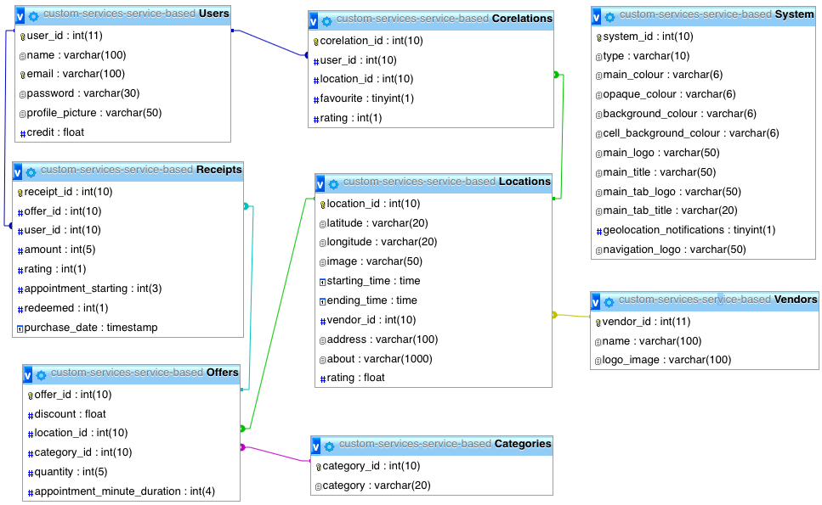
Database Templates
6 different types of systems
Location, product or service based
With or without offer categories
Service based system with offer categories
Appointments
Trigger

Slide 5
Server Template
The business logic of the system
Middleware between the presentation layer and the database
Customisable via a ”config.php” file

Slide 6
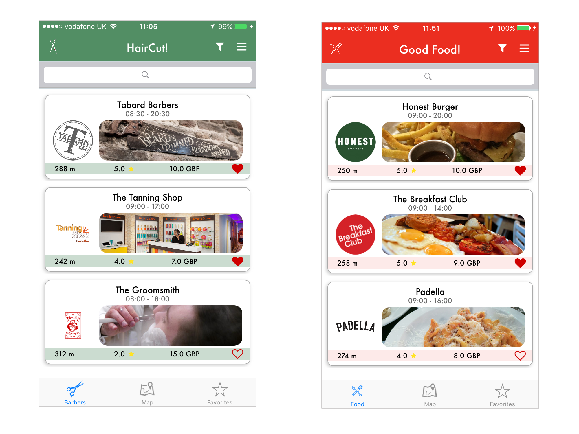
iOS Mobile Application Template
Main component of the system
Functionalities included:
Browse offers via a list or a map view
Manage favourites list
Provide rating score for offers
Offer purchasing
Appointment setting
Profile editing and credit management
User session storing
Receipt redeeming
Geolocation and local notifications
Multiple navigation options including Augmented Reality directions

Slide 7
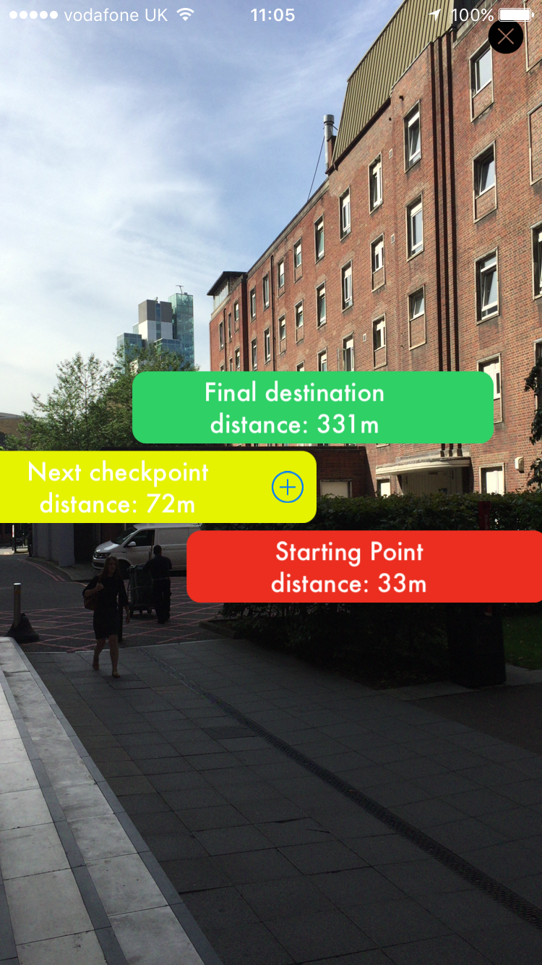
iOS Mobile Application Template
Augmented Reality navigation system
The “Starting Point” is the device’s current location
The checkpoints are the step-by-step directions that need to be followed
The “Final Destination” is the location of the specific vendor
Uses the device’s location services, gyroscope sensors and back camera.

Slide 8
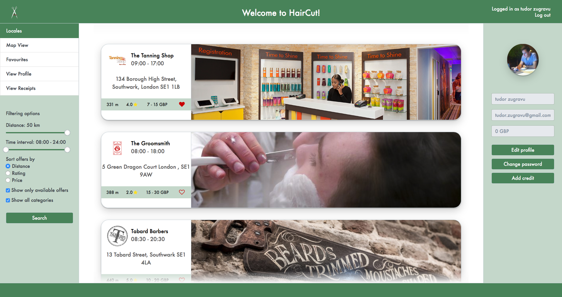
Web Application Template
Second presentation platform
Same functionalities as the iOS application
Except the Augmented Reality navigation and receipt redeeming
To be deployed next to the server component

Slide 9
Generation System
Takes input from potential clients
Customisation criteria
System type
Optional functionalities
Generates a complete solution that can be downloaded.
Provides step-by-step instructions on how to deploy the end system.

Slide 10
Conclusion
The success criteria have been satisfied
The development phases have been described in the final report.
Possible further developments include:
Developing an admin interface for managing the offers list.
Database triggers to reset the stock over night.
Data analysis functionalities.

Slide 11
Thank you for your attention!

